Slide 1
The Dutch Preliminary Procedure: Questions from lower courts to the Dutch Supreme Court International workshop on the subject of E-justice, Consumer Protection & Corporate Social Responsibility
prof. dr. Bart Krans |2 March 2025 Ritsumeikan University

Slide 2
preliminary procedure: overview
national procedure
questions from district courts (and courts of appeal) to the Supreme Court
only on matters of law, also relevant for many other (possible) cases
after the answer of the Supreme court, the district court will resume handling the case

Slide 3
why was the preliminary procedure introduced?
report 2008: ‘strengthening justice in cassation’ identified several problems on ‘justice in cassation’, inter alia:
several cases with important legal questions did not come up to the Supreme Court
not good for legal certainty nor for development of law
therefore: preliminary procedure was introduced
in 2012 the Act on the preliminary procedure came into force

Slide 4
possible pros of the Act on preliminary procedure
the possibility of obtaining rapid clarity in the highest instance on questions of law
possibility of preventing many individual claims
preventing possibly many individual cases, with perhaps contradicting outcomes
promotes unity of justice and development of the law
contributes to a more optimal performance of the lawmaking task of the Supreme Court in cases where the social need for a response is great
These possible pros were mentioned in parliamentary documents (number 32 612) concerning the Act (so prior to introduction of the Act)

Slide 5
possible cons of the Act on preliminary procedure
delay and complication of first instance and appeal proceedings
risk of shifting workload to Supreme Court
These possible downsides were mentioned in the 2008 report on strengthening procedure in cassation
(prior to introduction of the Act).

Slide 6
when? conditions for referring questions
what type of questions can be referred to the Supreme Court on this basis?
several conditions for referring a question to the Dutch Supreme Court (art. 392 DCCP), inter alia two core requirements:
only questions of Law
answer is necessary to decide on the case at hand and relevant for other a multitude of other cases as well

Slide 7
preliminary procedure: first steps
if district court or court appeal considers to refer questions of law to Supreme court it consults the litigating parties
if district court refers the question to the Supreme Court: proceedings before the district court are suspended (untill decision from the Supreme Court is received)
Supreme Court decides whether to hear the case or not (‘green light or red light’)

Slide 8
preliminary procedure: after ‘green light’
questions to Supreme Court are asked by the lower court, nevertheless:
parties are entitled to submit their views to the Supreme Court
third persons (non-parties) can present their view as well (after permission)
case is published on website of Supreme Court
Attorney-General provides an advice on the matter
Supreme Court gives a decision
lenght of this preliminary proceedings?

Slide 9
after the answer of the Supreme Court
after the Dutch Supreme Court has given its decision
district court (or court of appeal) will resume handling and deciding the case
after final judgement of district court, one of the parties can lodge an appeal (to Court of Appeal)
if so, after final judgement of Court of Appeal, one of the parties may take case up to Supreme Court
(in some way: again, but in another way: for the first time)

Slide 10
some numbers
July 2012: Act into force
June 2021: Supreme Court received question number 100
these first 100 cases:
68 questions by district courts
32 questions by courts of appeal
last years: around 13 cases per year (more than anticipated)

Slide 11
questions so far
Questions that were referred so far concern various areas of civil law, mainly:
insolvency law
procedural law
family law
law of damages and
consumer law

Slide 12
some ‘high profile’ cases
SC 13 June 2014, ECLI:NL:HR:2014:1385 (telecom)
SC HR 21 april 2017, ECLI:NL:HR:2017:773 (financial products)
SC 19 July 2019, ECLI:NL:HR:2019:1278 (damage to houses, caused by gas drilling)
SC 19 November 2021, ECLI:NL:HR:2021:1725 (air bnb)
SC 24 December 2021, ECLI:NL:HR:2021:1974 (rent reduction during pandemic?)

Slide 13
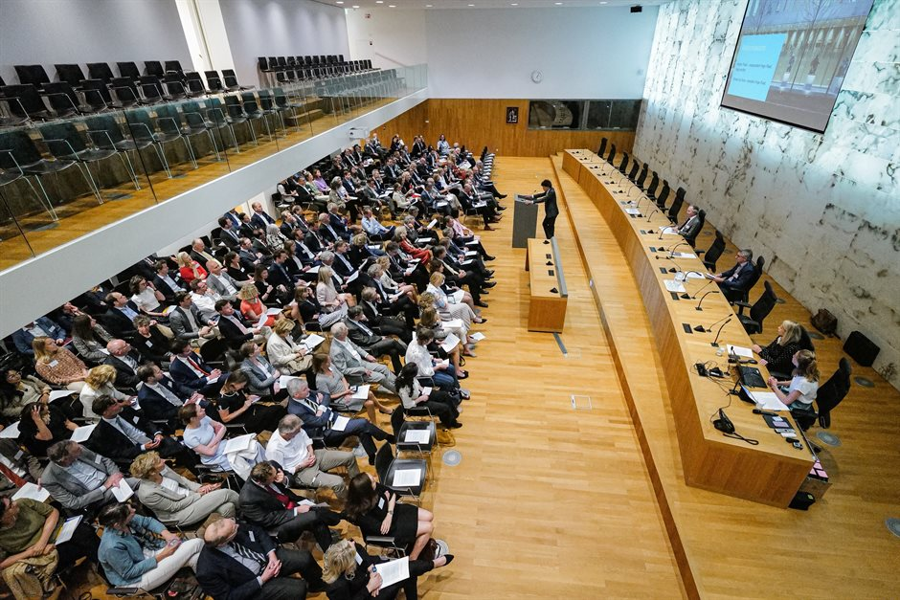
symposium Supreme Court July 2022
Picture: www.hogeraad.nl

Slide 14
after the first 10 years of the Act
positive aspects (mentioned among scholars etc.)
the preliminary procedure promotes
development of the law
legal protection
legal unity
negative aspects (mentioned among scholars etc.)
too much focus on these proceedings and thus less attention to ordinary cases
Supreme Court should be a little stricter

Slide 15
final remarks
at the time the Act came into force (in 2012) it only applied to civil cases
since 2016 also applicable in tax cases
since 2022 also applicable in criminal cases
nowadays it is argued that the Act should also be opened for administrative cases (although there is another highest court for administrative cases than the Supreme Court)
room for improvement of the Act

